Slide 1
Vector Integral Calculus
Lecture 5
Surface integrals
Triple integrals. Divergence theorem of Gauss

Slide 2
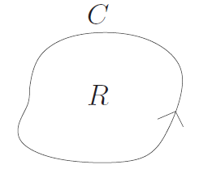
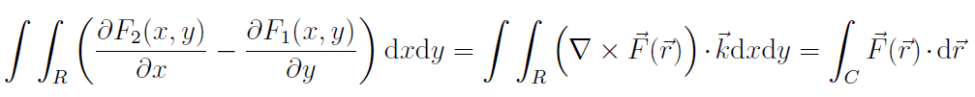
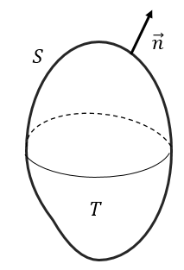
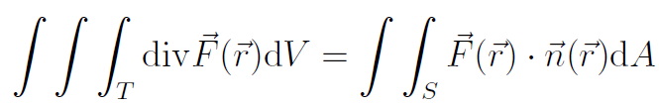
Transforming different integrals into one another
One type of integral might be easier to evaluate than another.
Last time we transformed double integrals into line integrals and :
Greens theorem:
J. Schmiegel: Lecture notes
Today we are working with surface integrals, triple integrals and Gauss divergence theorem.
Gauss divergence theorem transforms a triple integral into a surface integral and vice versa:

Slide 3
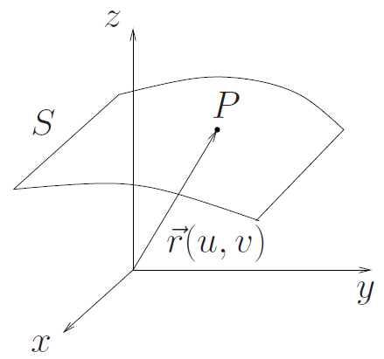

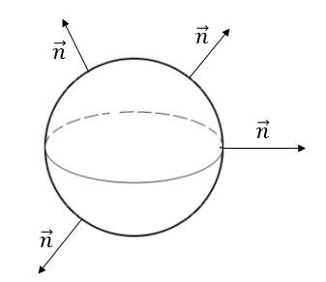
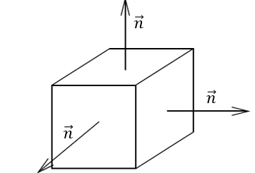
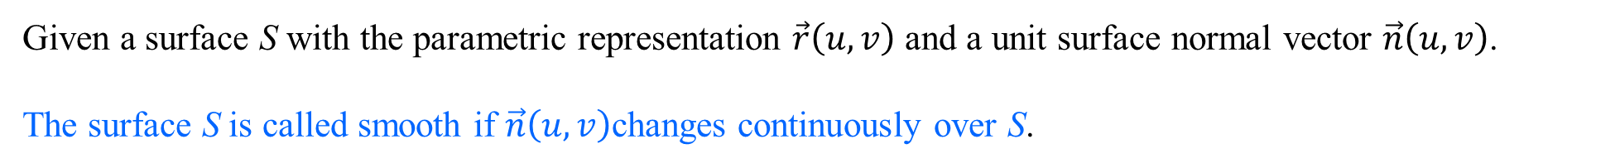
Parametric representation of a surface S
A parametric representation of a surface S is described by the position vectors of the points on S
where u and v are suitable variables within a certain range.
J. Schmiegel: Lecture notes
Given a surface S with the parametric representation $\vec{r}\left(u,v\right)$ and a unit surface normal vector $\vec{n}\left(u,v\right)$.
The surface S is called smooth if $\vec{n}\left(u,v\right)$changes continuously over S.
J. Schmiegel: Lecture notes
The surface S is called piecewise smooth if S consists of ﬁnitely many smooth surfaces.
J. Schmiegel: Lecture notes

Slide 4

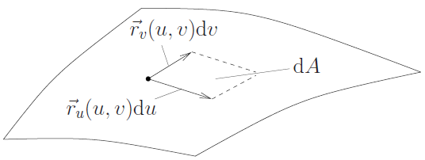

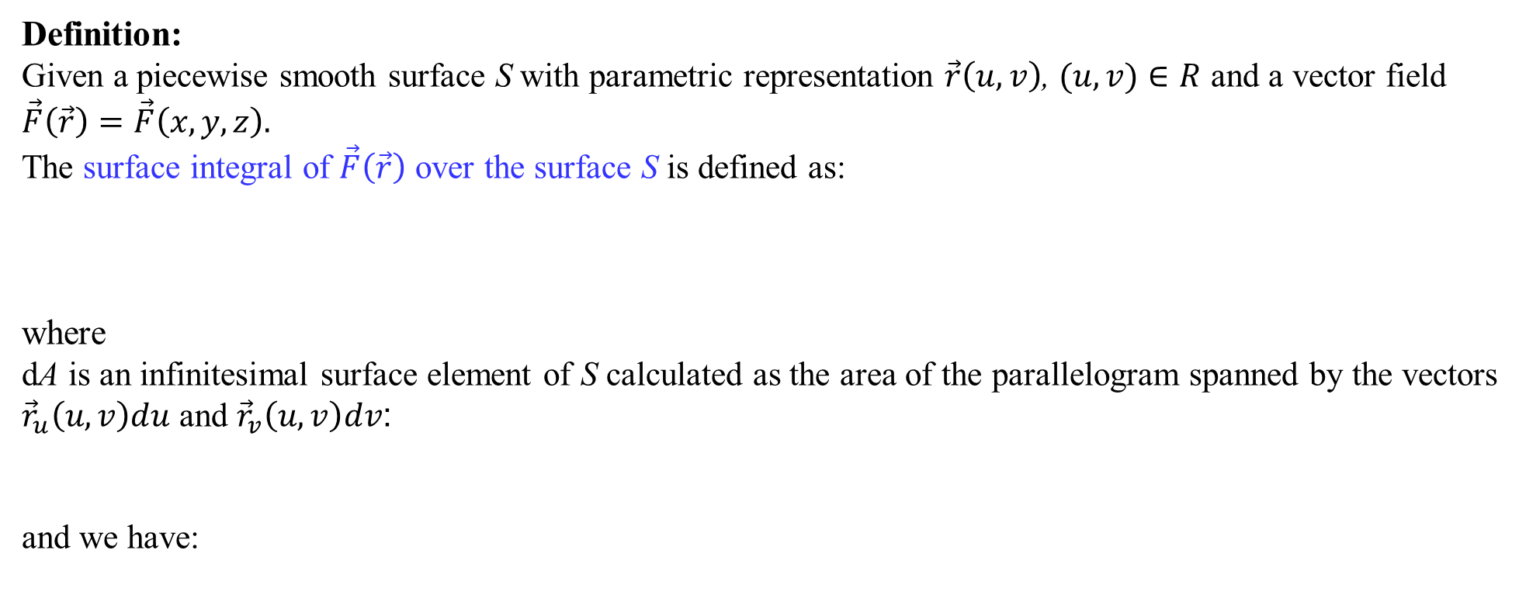
Surface integrals
Definition:
Given a piecewise smooth surface S with parametric representation $\vec{r}\left(u,v\right)$, $(u,v)∈R$ and a vector field $\vec{F}\left(\vec{r}\right)=\vec{F}\left(x,y,z\right).$
The surface integral of $\vec{F}\left(\vec{r}\right)$ over the surface S is defined as:
where
dA is an infinitesimal surface element of S calculated as the area of the parallelogram spanned by the vectors
${\vec{r}}_{u}\left(u,v\right)du$ and ${\vec{r}}_{v}\left(u,v\right)dv$:
and we have:
J. Schmiegel: Lecture notes

Slide 5

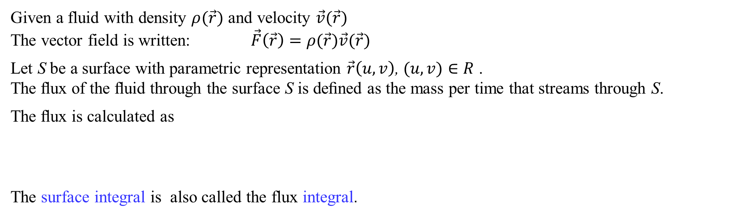
Flux through a surface
Given a fluid with density $ρ(\vec{r})$ and velocity $\vec{v}(\vec{r})$
The vector field is written: $\vec{F}\left(\vec{r}\right)=ρ(\vec{r})\vec{v}(\vec{r})$
Let S be a surface with parametric representation $\vec{r}\left(u,v\right)$, $(u,v)∈R$ .
The ﬂux of the ﬂuid through the surface S is deﬁned as the mass per time that streams through S.
The ﬂux is calculated as
The surface integral is also called the flux integral.

Slide 6
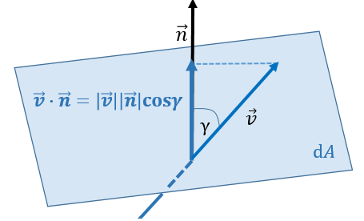




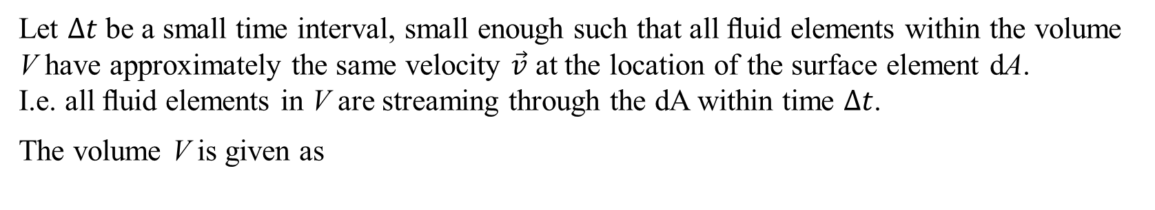
Flux through a surface
The geometry behind the flux integral
Let $∆t$ be a small time interval, small enough such that all ﬂuid elements within the volume V have approximately the same velocity $\vec{v}$ at the location of the surface element dA.
I.e. all ﬂuid elements in V are streaming through the dA within time $∆t$.
The volume V is given as
h
Then the mass of ﬂuid in V is:
$$\vec{F}=ρ\vec{v}$$
and the mass per time streaming through dA in direction $\vec{n}$ is:

Slide 7
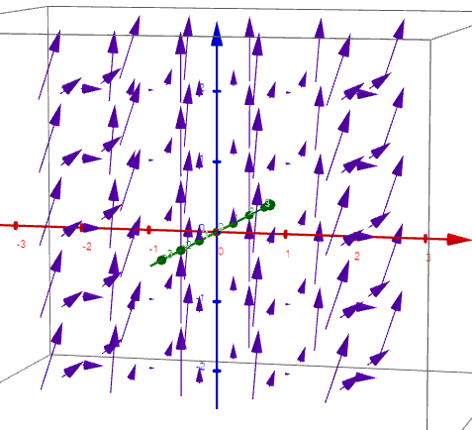
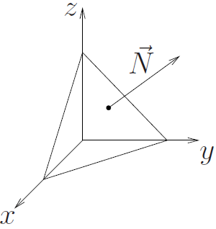
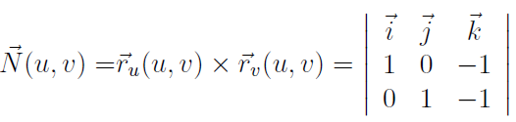
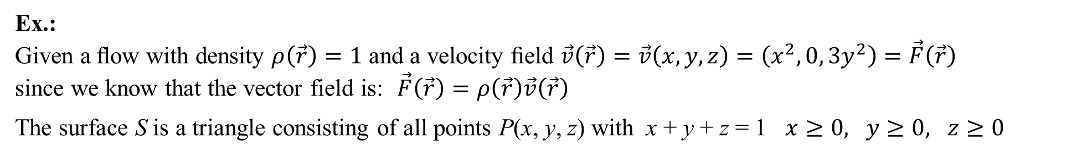
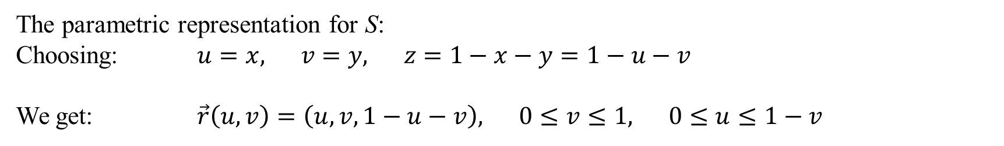
Flux through a surface
Ex.:
Given a ﬂow with density $ρ\left(\vec{r}\right)=1$ and a velocity ﬁeld $\vec{v}\left(\vec{r}\right)=\vec{v}\left(x,y,z\right)=\left(x^{2},0,{3y}^{2}\right)=\vec{F}\left(\vec{r}\right)$
since we know that the vector field is: $\vec{F}\left(\vec{r}\right)=ρ\left(\vec{r}\right)\vec{v}\left(\vec{r}\right)$
The surface S is a triangle consisting of all points P(x, y, z) with x + y + z = 1 $x≥0, y≥0, z≥0$
The parametric representation for S:
Choosing: $u=x, v=y, z=1−x−y=1−u−v$
We get: $\vec{r}\left(u,v\right)=\left(u,v,1−u−v\right), 0≤v≤1, 0≤u≤1−v$
J. Schmiegel: Lecture notes
The tangent vectors: ${\vec{r}}_{u}\left(u,v\right)=(1,0,−1)$ ${\vec{r}}_{v}\left(u,v\right)=(0,1,−1)$
The surface normal vector:
= (1,1,1)

Slide 8







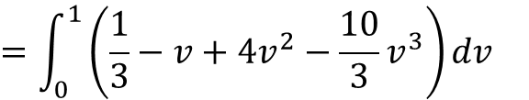
Flux through a surface
Ex. cont.:
The ﬂux through the surface S is:
J. Schmiegel: Lecture notes
$$=\int_{0}^{1}{\left(\frac{1}{3}−v+{4v}^{2}−\frac{10}{3}v^{3}\right)dv}$$
i.e. that the flux streaming through the surface S is $\frac{1}{3}$ $\frac{kg}{s}$ in the direction of $\vec{N}$

Slide 9

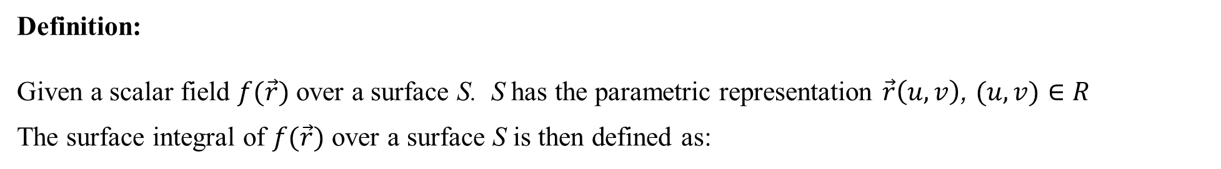
Another surface integral
Definition:
Given a scalar field $f(\vec{r})$ over a surface S. S has the parametric representation $\vec{r}\left(u,v\right)$, $(u,v)∈R$
The surface integral of $f(\vec{r})$ over a surface S is then defined as:
If $f(\vec{r})$ is the surface density at the point $\vec{r}$ (mass per area) then the surface integral gives the mass of the surface.

Slide 10

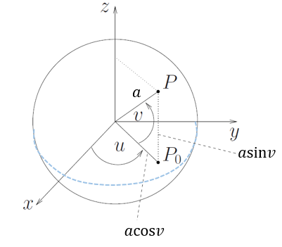

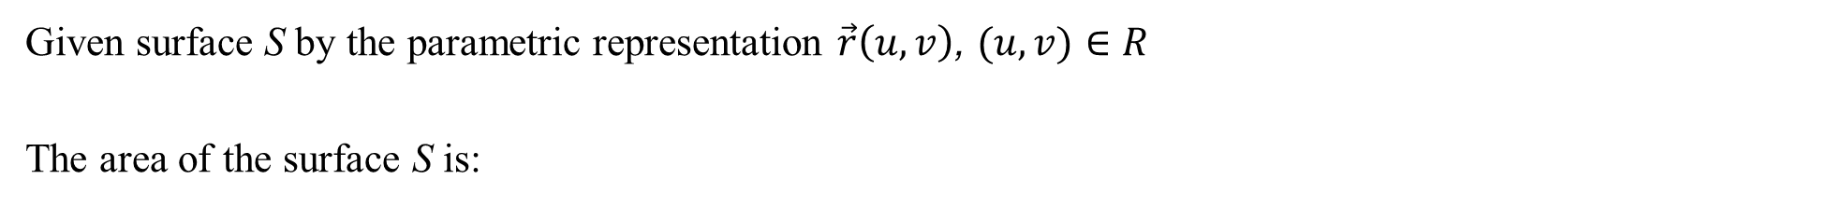
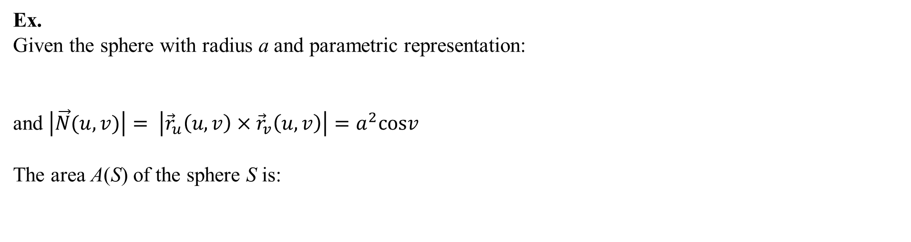
Area of a surface
Given surface S by the parametric representation $\vec{r}\left(u,v\right)$, $(u,v)∈R$
The area of the surface S is:
Ex.
Given the sphere with radius a and parametric representation:
and $\left|\vec{N}(u,v)\right|= \left|{\vec{r}}_{u}\left(u,v\right)× {\vec{r}}_{v}\left(u,v\right)\right|=a^{2}cosv$
The area A(S) of the sphere S is:
J. Schmiegel: Lecture notes

Slide 11
Triple integrals. Divergence theorem of Gauss

Slide 12

Useful formulas
Integration by parts:
The powers of trigonometric functions:
$$\cos^{2}t= \frac{1}{2}(1+cos2t)$$
$$\sin^{2}t= \frac{1}{2}(1−cos2t)$$

Slide 13

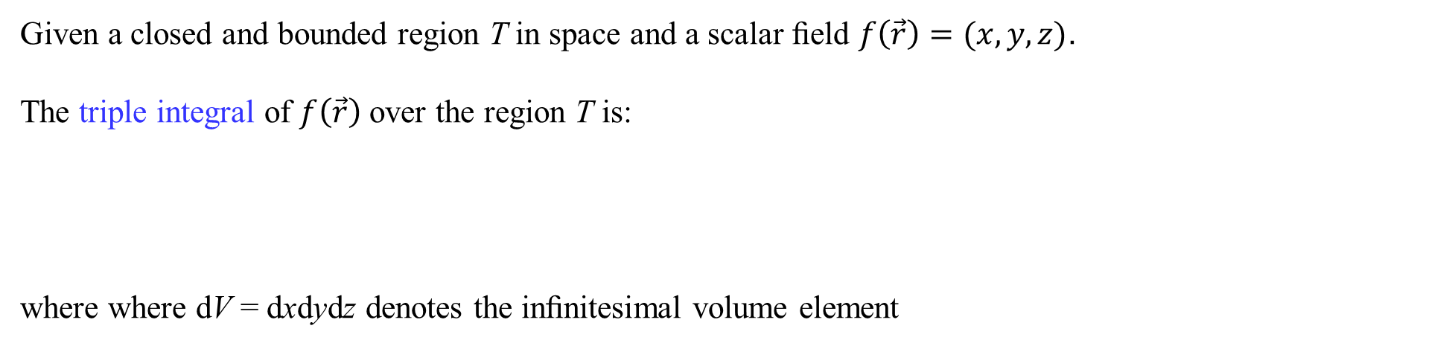
Triple integrals
Given a closed and bounded region T in space and a scalar ﬁeld $f\left(\vec{r}\right)=(x,y,z)$.
The triple integral of $f\left(\vec{r}\right)$ over the region T is:
where where dV = dxdydz denotes the inﬁnitesimal volume element

Slide 14

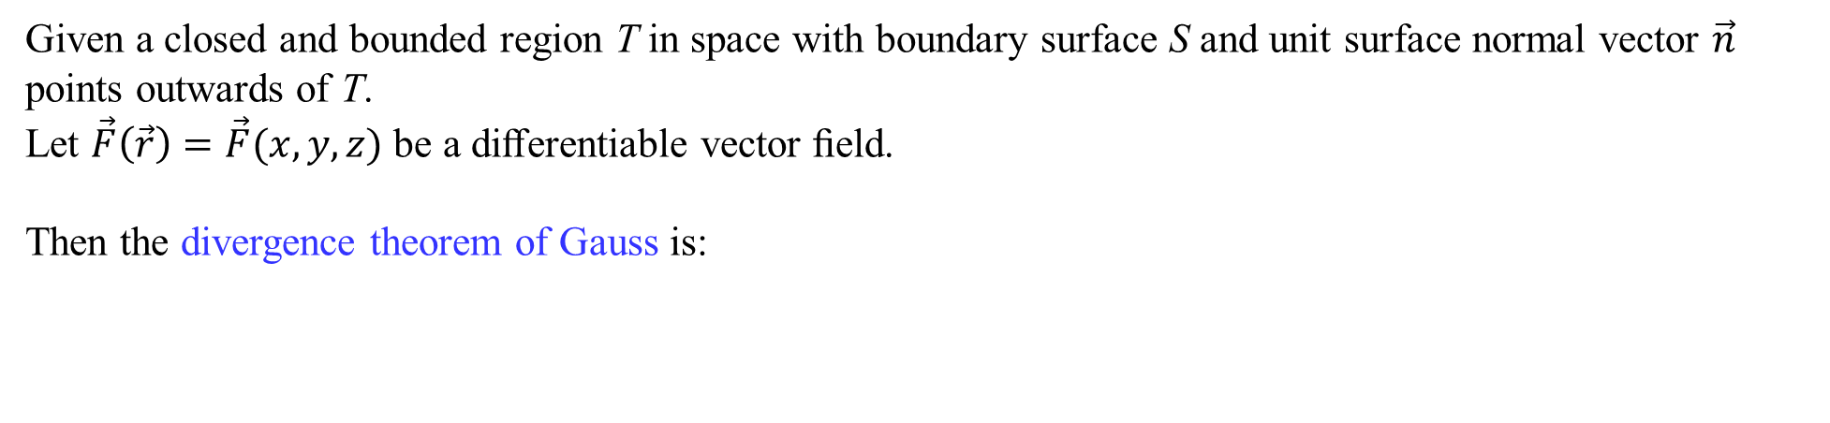
Divergence theorem of Gauss
Given a closed and bounded region T in space with boundary surface S and unit surface normal vector $\vec{n}$ points outwards of T.
Let $\vec{F}\left(\vec{r}\right)=\vec{F}(x,y,z)$ be a diﬀerentiable vector ﬁeld.
Then the divergence theorem of Gauss is:
The divergence theorem of Gauss relates a triple integral to a surface integral.

Slide 15
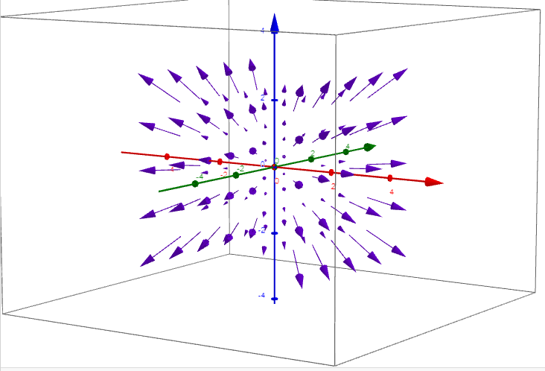

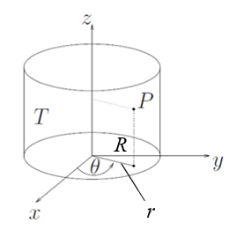
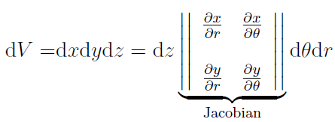



Triple integrals. Divergence theorem of Gauss
Ex.
Given a region T bounded by a cylinder along the z–axis of height b and radius R and
a vector ﬁeld
Let P(x, y, z) be any point in T.
For the xy–coordinates of P we use polar coordinates:
The volume element dV = dxdydz then transforms into:
J. Schmiegel: Lecture notes

Slide 16



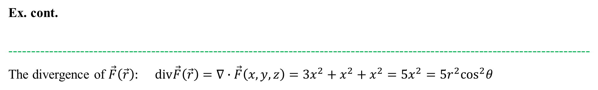

Triple integrals. Divergence theorem of Gauss
Ex. cont.
-----------------------------------------------------------------------------------------------------------------------------------
The divergence of $\vec{F}\left(\vec{r}\right):$ $div\vec{F}\left(\vec{r}\right)=∇∙\vec{F}\left(x,y,z\right)={3x}^{2}+x^{2}+x^{2}={5x}^{2}=5r^{2}\cos^{2}θ$
$$dV=rdθdrdz$$
Then the triple integral is:
J. Schmiegel: Lecture notes

Slide 17

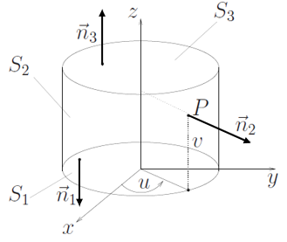
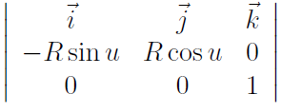

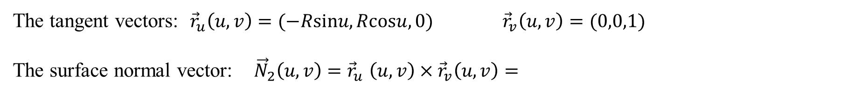
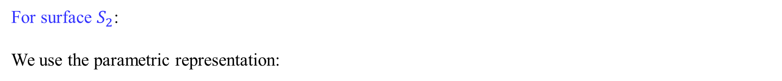

Triple integrals. Divergence theorem of Gauss
We now calculate the same integral using divergence theorem of Gauss:
$$=I_{1}+I_{2}+I_{3}$$
For surface $S_{2}$:
We use the parametric representation:
The tangent vectors: ${\vec{r}}_{u}\left(u,v\right)=(−Rsinu,Rcosu,0)$ ${\vec{r}}_{v}\left(u,v\right)=(0,0,1)$
The surface normal vector: ${\vec{N}}_{2}\left(u,v\right){=\vec{r}}_{u}\left(u,v\right)× {\vec{r}}_{v}\left(u,v\right)=$
J. Schmiegel: Lecture notes
The length :

Slide 18





Triple integrals. Divergence theorem of Gauss
Ex. cont.
--------------------------------------------------------------------------------------------------------------------------------
For surface $S_{2}$ cont.:
The unit surface normal vector:
The surface integral:
J. Schmiegel: Lecture notes

Slide 19
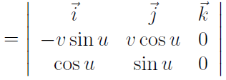
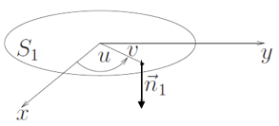

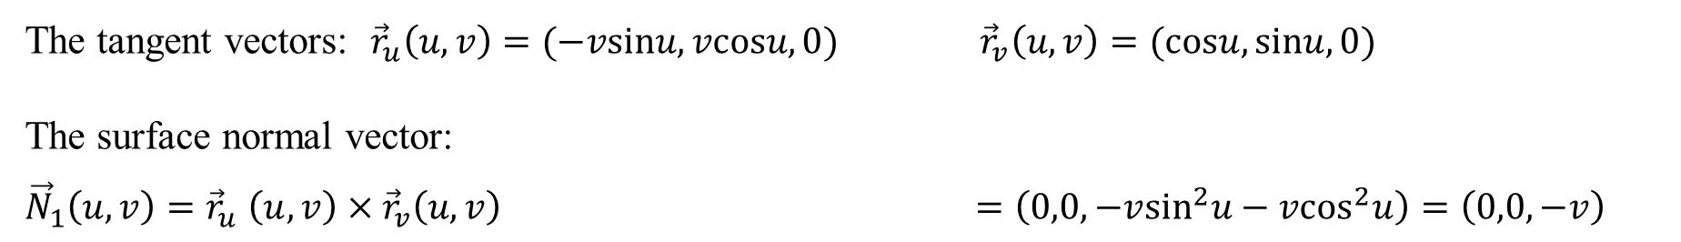
Triple integrals. Divergence theorem of Gauss
Ex. cont.
--------------------------------------------------------------------------------------------------------------------------------
For surface $S_{1}$:
We use the parametric representation:
The tangent vectors: ${\vec{r}}_{u}\left(u,v\right)=(−vsinu,vcosu,0)$ ${\vec{r}}_{v}\left(u,v\right)=(cosu,sinu,0)$
The surface normal vector:
${\vec{N}}_{1}\left(u,v\right){=\vec{r}}_{u}\left(u,v\right)× {\vec{r}}_{v}\left(u,v\right)$ $=\left(0,0,−v\sin^{2}u−v\cos^{2}u\right)=\left(0,0,−v\right)$
The unit surface normal vector: :
J. Schmiegel: Lecture notes

Slide 20
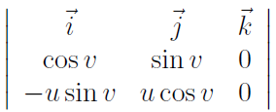
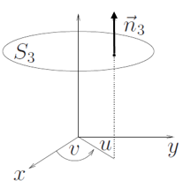

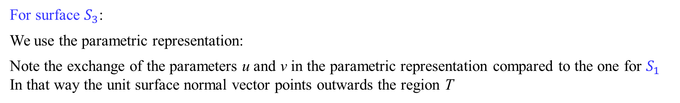
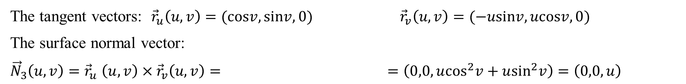
Triple integrals. Divergence theorem of Gauss
Ex. cont.
--------------------------------------------------------------------------------------------------------------------------------
For surface $S_{3}$:
We use the parametric representation:
Note the exchange of the parameters u and v in the parametric representation compared to the one for $S_{1}$
In that way the unit surface normal vector points outwards the region T
The tangent vectors: ${\vec{r}}_{u}\left(u,v\right)=(cosv,sinv,0)$ ${\vec{r}}_{v}\left(u,v\right)=(−usinv,ucosv,0)$
The surface normal vector:
${\vec{N}}_{3}\left(u,v\right){=\vec{r}}_{u}\left(u,v\right)× {\vec{r}}_{v}\left(u,v\right)=$ $=\left(0,0, u\cos^{2}v+u\sin^{2}v\right)=\left(0,0,u\right)$
The unit surface normal vector: :
J. Schmiegel: Lecture notes

Slide 21


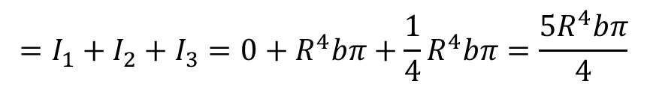
Triple integrals. Divergence theorem of Gauss
Ex. cont.
--------------------------------------------------------------------------------------------------------------------------------
For surface $S_{3}$ cont.:
The surface integral:
J. Schmiegel: Lecture notes
The total flux through the 3 surfaces :
$$=I_{1}+I_{2}+I_{3}=0+R^{4}bπ+\frac{1}{4}R^{4}bπ=\frac{5R^{4}bπ}{4}$$

Slide 22
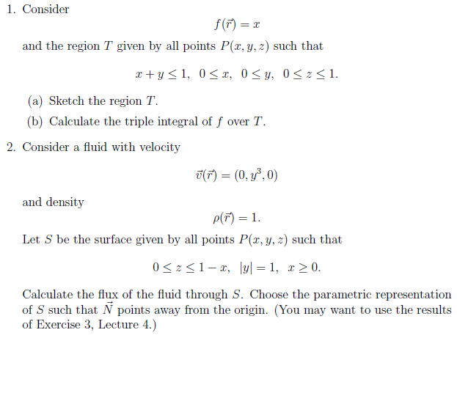
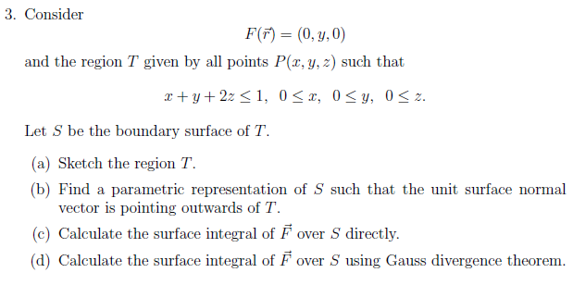
We are doing exercises from lecture notes 5

Slide 23
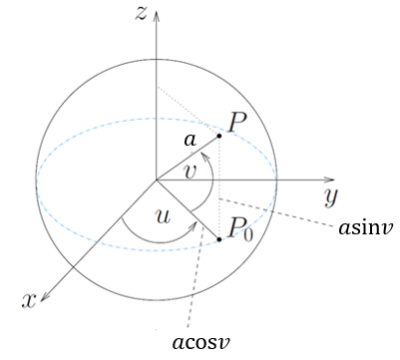


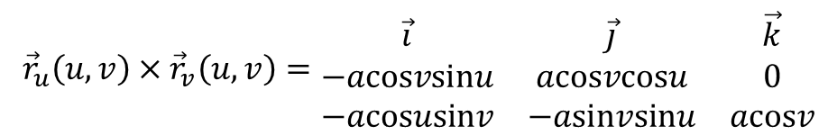

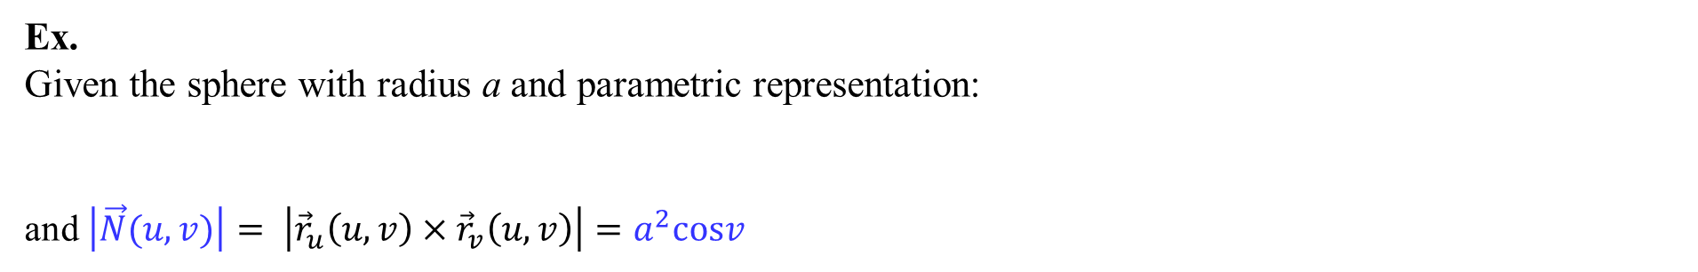




Area of a surface
Ex.
Given the sphere with radius a and parametric representation:
and $\left|\vec{N}(u,v)\right|= \left|{\vec{r}}_{u}\left(u,v\right)× {\vec{r}}_{v}\left(u,v\right)\right|=a^{2}cosv$
J. Schmiegel: Lecture notes
We have:
$${\vec{r}}_{u}\left(u,v\right)=(−acosvsinu,acosvcosu,0)$$
$${\vec{r}}_{v}\left(u,v\right)=(−acosusinv,−asinvsinu,acosv)$$
$${\vec{r}}_{u}\left(u,v\right)× {\vec{r}}_{v}\left(u,v\right)=\begin{matrix}\vec{i} & \vec{j} & \vec{k} \\ −acosvsinu & acosvcosu & 0 \\ −acosusinv & −asinvsinu & acosv\end{matrix}$$
$$=$$
${(a}^{2}\cos^{2}vcosu,a^{2}\cos^{2}vsinu,a^{2}\sin^{2}ucosvsinv$+$a^{2}\cos^{2}ucosvsinv$)
$$=$$
${(a}^{2}{(cos}^{2}vcosu, \cos^{2}vsinu, \sin^{2}ucosvsinv$+$\cos^{2}ucosvsinv$))
$$=$$
${(a}^{2}{(cos}^{2}vcosu, \cos^{2}vsinu, {cosvsinv(sin}^{2}u$+$\cos^{2}$u))
${=(a}^{2}{(cos}^{2}vcosu, \cos^{2}vsinu,cosvsinv$) ${=(a}^{2}cosv(cosvcosu,cosvsinu, sinv$)
$$Then:{\left|{\vec{r}}_{u}\left(u,v\right)× {\vec{r}}_{v}\left(u,v\right)\right|}^{2}=$$
$$a^{4}\cos^{2}v\left(\cos^{2}v\cos^{2}u+\cos^{2}v\sin^{2}u+\sin^{2}v\right)=a^{4}\cos^{2}v\left(\cos^{2}v(\cos^{2}u+\sin^{2}u)+\sin^{2}v\right)$$
$$=a^{4}\cos^{2}v\left(\cos^{2}v+\sin^{2}v\right)=a^{4}\cos^{2}v$$
and then $\left|{\vec{r}}_{u}\left(u,v\right)× {\vec{r}}_{v}\left(u,v\right)\right|=a^{2}cosv$

